Slide 1
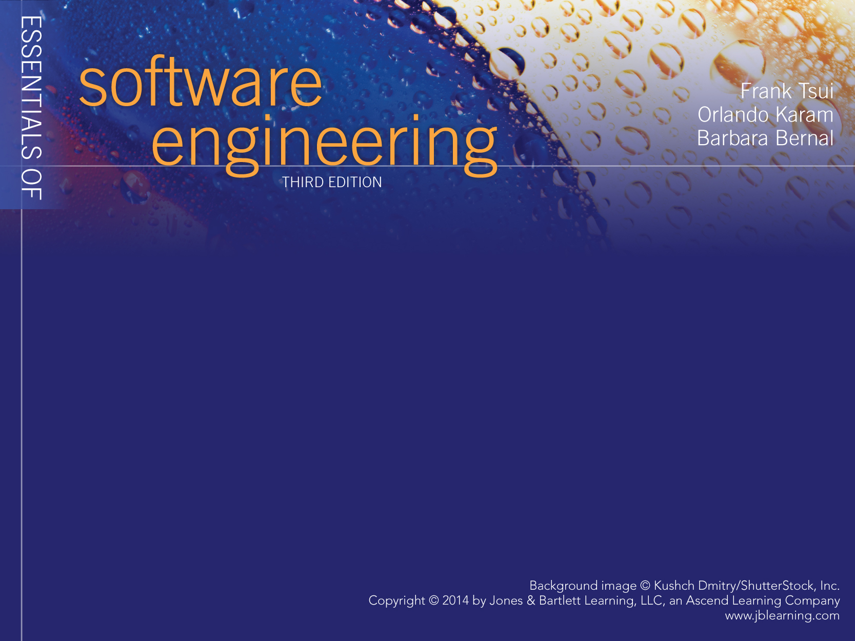
Chapter 4
Software Process Models

Slide 2

What is a Process Model ?
It is a description of
i) what tasks need to be performed in
ii) what sequence under
iii) what conditions by
iv) whom to
achieve the “desired results.”

Slide 3
Why Have A Process Model?
Provide “guidance” for a systematic coordination and controlling of
  a) the tasks and of
  b) the personnel who perform the tasks
Note the key words: coordination/control , tasks, people

Slide 4
Do we need a process if the project requires just 1 person or at most two people?
Why? -- Why not ?

Slide 5
A “Simple and Familiar” Process
Problem
Statement
Unit
Testing
Coding
Compiling
Release
problem
problem
Debugging
1. Most people performs and follow this simple process, but unfortunately some skips unit testing or debugging.
2. Also, some proceeds without thoroughly considering & understanding the “problem statement” ---- which is the requirement

Slide 6
Extending the “Simple” Process
As projects got larger and more complex.
(earlier, we introduced “simplification”, “better tools”, & “process”)
  Needed to clarify and stabilize the requirements
  Needed to test more functionalities
  Needed to design more carefully
  Needed to use more existing software & tools
    Database
    Network
    Code control
  Needed more people to be involved
Resulting in more tasks and more people

Slide 7
With More People and More Tasks
We now need to “Define”:
  the set of tasks that need to be performed
  the sequence of flow of the tasks
  the input and the output from these tasks
  the pre-condition and post-conditions for each task
  The people & skills needed to perform the tasks

Slide 8
Some “traditional” software development processes
The earlier “simple” process was employed by many for years without formally embracing other important development activities such as requirements analysis, design, formal testing, or packaging.
The recognition of the need for formal processes was initially driven by failures in developing large complex software --- (later shown by Chaos reports)
  Waterfall : earliest process and coping with no process
  Incremental : coping with decomposing the large systems
  Spiral : coping with risk management
  Rational Unified Process : coping with different task and managing through project phases

Slide 9
Waterfall Model
1. Requirements must be specified in the
first step.
2. Four main tasks must be completed in
sequence: requirements, design, code,
and test, followed by packaging.
3. Output of one stage feeds into the next
stage in sequence, and thus easily
tracked (“controlled”) by management
Requirements
Design
Code
Test
Integrate and
Package

Slide 10
Incremental Model (A)– “Continuous Integration”
1. Each “major requirement/item”
is further developed separately through
the same sequence of : requirement,
design, code, and unit test.
2. As the developed pieces are completed,
they are continuously merged and
integrated into a common bucket for
integrated system test
Req. Analysis and Architecture
Req. 1
Req.2
. . .
Req. n
Des.
Des.
Des.
. . . .
code
code
code
. . . . . .
Test
Test
Test
. . . . . .
System
Test
Integration Bucket

Slide 11
Incremental Model (B) - “Multiple Releases”
(seed for today’s “Agile” processes)
Requirements
Design
Code
Test
Package
Rel. 1
.
.
.
Requirements
Design
Code
Test
Package
Rel. n
Each small set of requirements is developed,
packages, and released in a multiple release
fashion.

Slide 12
Spiral Model
Determine Objectives,
Alternatives, Constraints
Evaluate Alternatives,
Identify, Resolve Risks
risk
analysis
design
model
proto
type
“Review”
req. plan
req.
Spec.
design
code
dev plan
design
validation
unit
test
test plan
Develop, Verify
Next-level Product
Plan Next Phase
sys.
test
-developed by B. Boehm of TRW
- Software development
activities are cycled through
4 phases
A “Risk Averse” process first
proposed by Barry Boehm

Slide 13
Rational Unified Process (RUP)
Phases of Project
Activities
Inception
Elaboration
Construction
Transition
Requirements
Design
Implement
Test
Integrate
Every software development
activity is “addressed” in the 4
phases of inception, elaboration,
construction, and transition

Slide 14
Entry and Exit Criteria
Process
Activity
Exit
Criteria
Met?
Entry
Criteria
Met?
Yes
Yes
No
No
In order for process models to be more than just a “guideline,” it must include a list of conditions or requirements that define the:
- entry criteria prior to performing
an activity in a process.
- exit criteria before an activity in the
process is deemed completed.

Slide 15
Assessment of Software Organizations
Software Development and Software Support may be done with very little process or with very sophisticated, well defined, well organized and well executed processes.
How mature is your software engineering organization and do you need to improve?
ISO (ISO 9000 series) and SEI (Software Engineering Institute at Carnegie Mellon) are two leading organizations that help in the process assessment
No Process
Matured Process
Where are you in
this wide spectrum??

Slide 16
SEI’s Original CMM – Early 1990s
Software Engineering Institute (SEI) proposed a Capability Maturity Model (CMM) to help software organizations assess their maturity and provide guidance in software development.
  Initial : there is no process and any success is by luck or with a special person.
  Repeatable: has mastered 6 processes and can repeat its success with these 6 processes: 1) requirements mgmt, 2)project tracking, 3)quality assurance, 4)project planning, 5)subcontract mgmt, and 6)configuration management
  Defined: has mastered 7 more processes and is competent at software construction: 1) organization process, 2) training program, 3) product engineering, 4) peer review, 5) organization process definition, 6) integrated soft. mgmt, and 7) inter-group coordination
  Managed: has introduced 2 more processes that deal with quantitative measurement and quality: 1) quantitative process management and 2) quality mgmt
  Optimizing: reaching this highest level requires the mastering of continuous improvement with 3 more processes: 1)defect prevention, 2) technology change management, 3) process change management

Slide 17
SEI’s 5 Levels of Original “Capability Maturity Model” (CMM)
Most Mature
Optimizing
Level 5
Managed
Level 4
Defined
Level 3
Repeatable
Level 2
Initial
Level 1
Least Mature
Total of 18 processes need to be mastered to achieve “optimized” level
See page 92 of your text for the 18 “key” processes

Slide 18
SEI’s CMMI
In 2001, CMM was upgraded to CMMI (CMM Integrated). Started with multiple, major aspects to CMMI:
  Systems engineering
  Software engineering
  Integrated product and process development
  Supplier sourcing

Slide 19
2 Representations of CMMI
The software engineering portion of CMMI has two representations:
  Staged : similar to the CMM assessment of organization
  Continuous : better for assessing maturity of each process

Slide 20
Levels for Continuous versus Staged models in CMM I
Level 5
Optimizing
Optimizing
Level 4
Quantitatively Managed
Quantitatively Managed
Level 3
Defined
Defined
Level 2
Managed
Managed
Level 1
Performed
Initial
Level 0
Incomplete
- - - - - -
Continuous
(Capability Levels)
Staged
(Maturity Levels)

Slide 21
25 Processes of CMMI
There are 25 processes covering 4 major categories :
  Process Management (has 5 processes):
    Organization process focus
    Organizational process definition
    Organizational training
    Organizational process performance
    Organizational innovation and deployment
  Project Management (has 8 processes):
    Project planning
    Project monitoring and control
    Supplier agreement management
    Integrated project management
    Risk management
    Integrated teaming
    Integrated supplier management
    Quantitative project management

Slide 22
25 Processes of CMMI (cont,)
Engineering (has 6 processes)
  Requirements development
  Requirements management
  Technical solution
  Product integration
  Verification
  Validation
Support (has 6 processes)
  Configuration management
  Process and product quality assurance
  Measurement and analysis
  Organizational environment for integration
  Decision analysis and resolution
  Causal analysis and resolution

Slide 23
Continuous versus Staged Models
In Continuous Representation, each process starts at capability level 0 and moves up the capability levels based on achieving “generic goals” and “specific sub-goals.”
  Allows the organization to choose and pick the process to focus on based on the needs of the organization
  Allows comparison of process area by process area between organizations
  Allows easier migration from other standards
In Staged Representation, the organization starts at maturity level 1 and moves up the levels based on mastering sets of processes.
  Allows easy migration from the earlier CMM model
  Provides a guidance of sequence of maturity by process areas
  Allows easier comparison of organizations by maturity levels

Slide 24
Achieving the “Capability Levels” by each Process Area in the Continuous Representation Model
CL5
Optimizing
+ (Generic Goal 5)
CL4
Quantitatively Managed
+ (Generic Goal 4)
CL3
Defined
+ (Generic Goal 3)
CL2
Managed
+ (Generic Goal 2)
CL1
Performed
+ (Specific Goals)
+(Generic Goal 1)
CL0
Incomplete

Slide 25
5 Generic Goals
Goal 1 – Achieve all the specific goals of the specific process
Goal 2 – Institutionalize the managing of consistency of that process across organization
Goal 3 – Institutionalize the defining of that process across the organization
Goal 4 – Institutionalize quantitatively managing that process across the organization
Goal 5 - Institutionalize continuous optimizing/improving that process across the organization

Slide 26
Achieving “Maturity Level” (ML) in the
Staged Representation model
ML1 (0 process) : no process
ML2 (7 processes): 1)Requirements Mgmt, 2)Project planning, 3)Project monitoring, 4)Supplier agreement mgmt, 5)Measurement and analysis, 6)Process and product quality assurance, 7)Configuration mgmt
ML3 (14 processes): 1)Requirements development, 2)Technical solution, 3)Product integration, 4)Verification, 5)Validation, 6)Organizational process focus, 7)Organizational process definition, 8)Organizational training, 9)Integrated project management, 10)Risk management, 11)Integrated teaming, 12)Integrated supplier mgmt, 13)Decision analysis and resolution, 14)Organizational environment for integration
ML4 (2 processes): 1)Organizational process performance, 2)Quantitative project management
ML5 ( 2 processes): 1)Organizational innovation and deployment, 2)Causal analysis and resolution

Slide 27
Process Definition & Communication (extra)
Recap - 2 Main Components of Process Definition:
  Major activities
  Sequencing of activities
*Most of the organizations need to modify an existing process to better fit their needs ----- thus they must define in more detail and communicate the modified process definitions (a major endeavor)*
Expanding process definition to more “refined” level:
  Detailed description of the activities
  Control needed for entrance and exit of each activity and the ordering of the activities
  Artifacts that result from the activities
  Human resources required to perform the activities
  Tools that may be needed to aid the performance of the activities

